Slide 1


Symbiosis Foundation – Hungary
The life has a meaning
László Jakubinyi
Childhood Games – Alternative methods for the integration and recovery of children with Autism Spectrum Disorder no. 2023-2-RO01-KA210-ADU-000175630

Slide 2
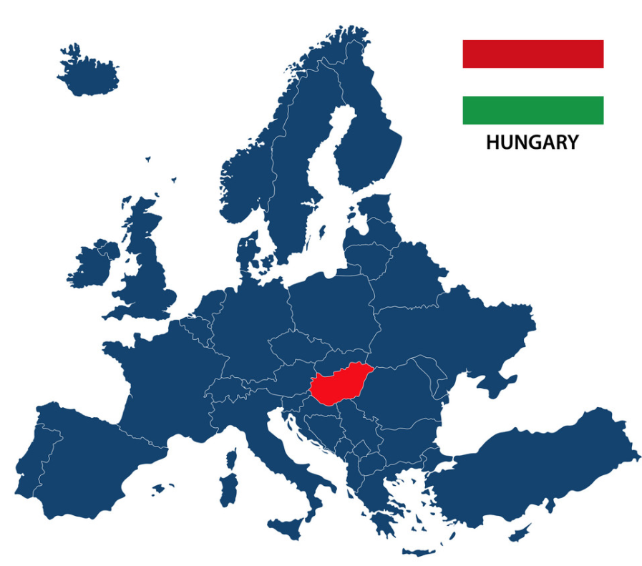
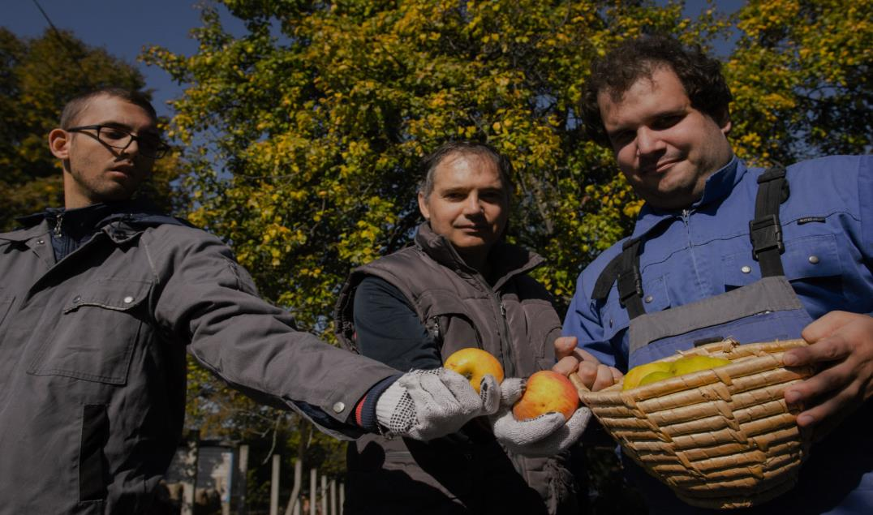
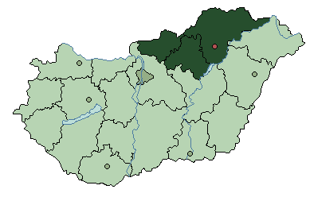
Symbiosis Foundation
since 1999
“
THERE MUST BE A POINT OF GETTING UP
IN THE MORNING
”

Slide 3
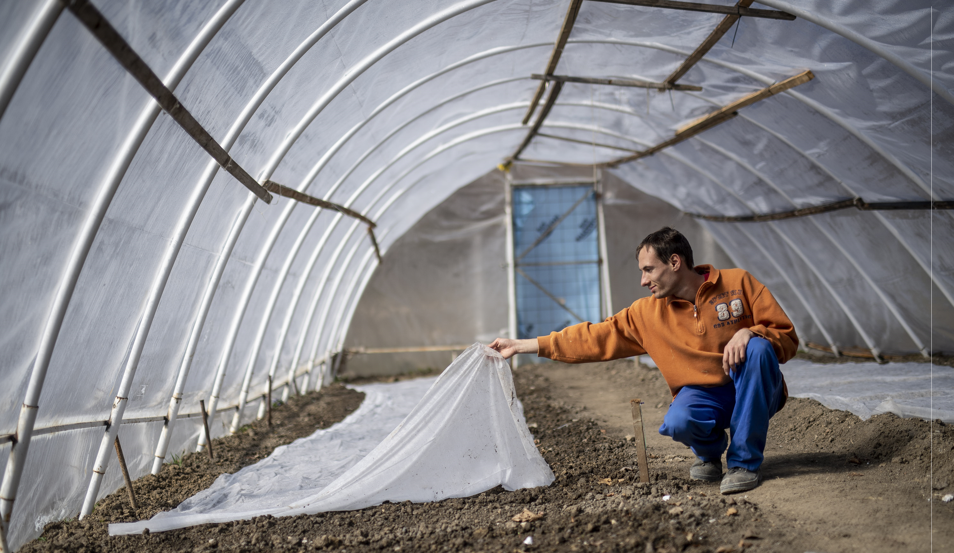






ABOUT US
People with disabilities
+ 500 persons
Residential care 80 persons
/ 9 houses
Employment 250 + persons from target group
COMMITTED
TO SOCIAL
PROGRESS
Different services, programs, developments
Operating social enterprises

Slide 4
supported housing & social services
employment: sheltered, inclusive workshops & labour integration
Social enterprises:
farming
food production
manufactures
touristic services
Supported employment service
Day care centers
Residential homes
Transport services
Catering
Respite care
01
02
Portfolio today
improving the
quality of life
03
04
progress in
the sector itself
Trainings
Therapies
Leisure activities
Community programs
Inclusive programmes
Networking
Integrational programmes
Lobbying
Innovative solutions

Slide 5
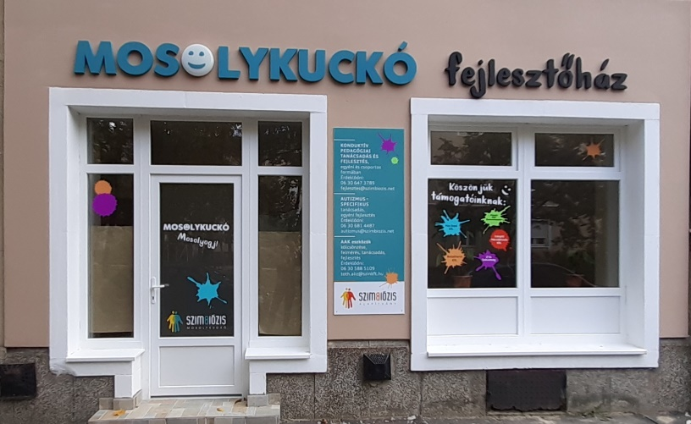
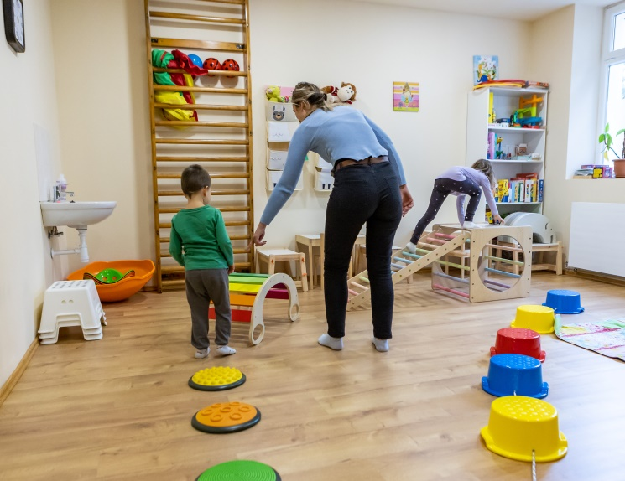
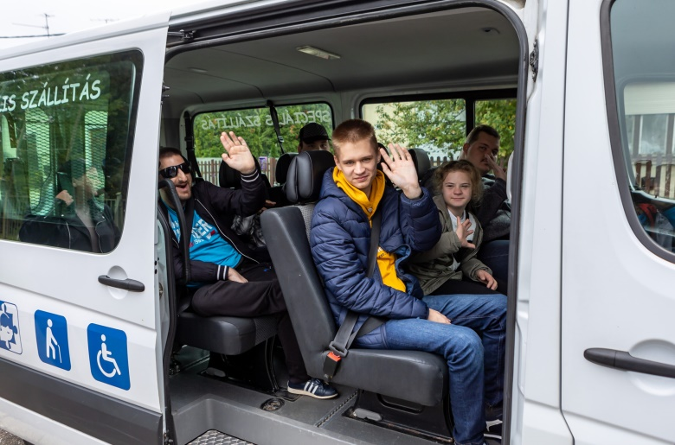
Relief for families
Autism counselling - Smiley Face Centre
AAC Centre - Augmentative and alternative communication support, development, counselling, equipment hire
Babysitting service
Special transport
Summer camps

Slide 6
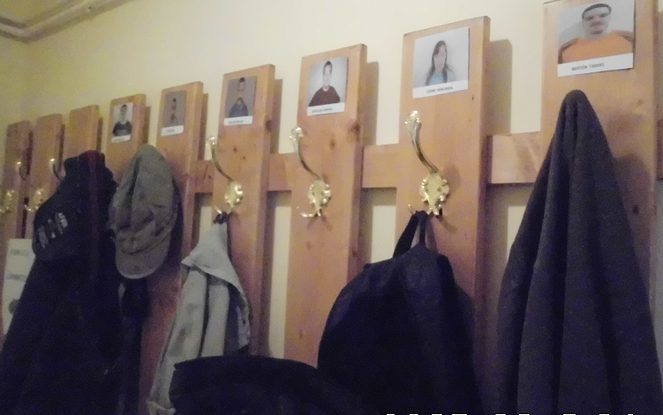
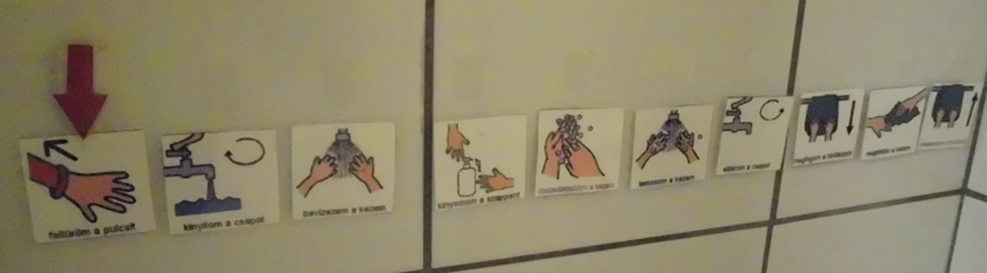
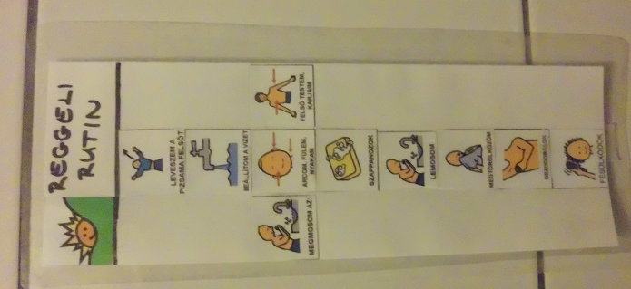
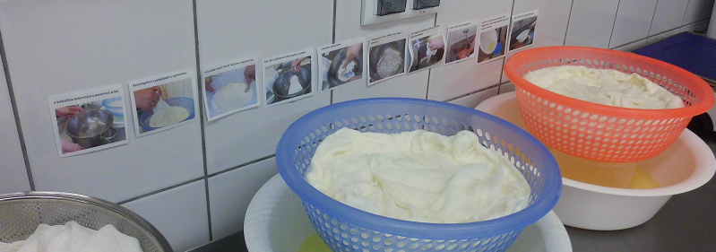
Visual support

Slide 7
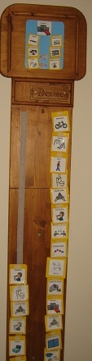
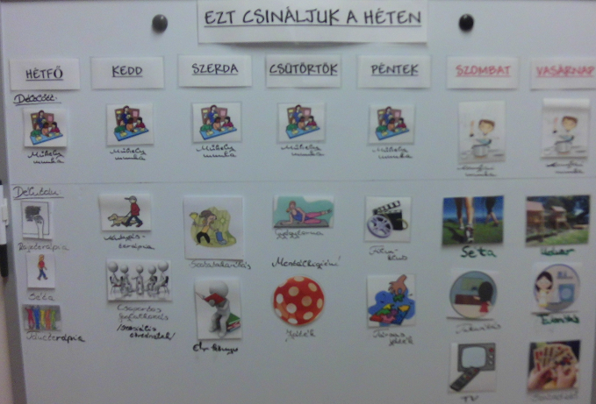
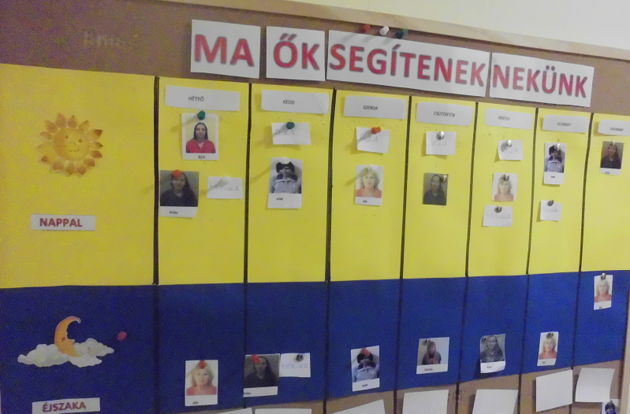
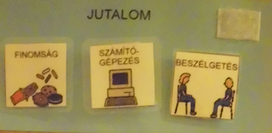

Slide 8
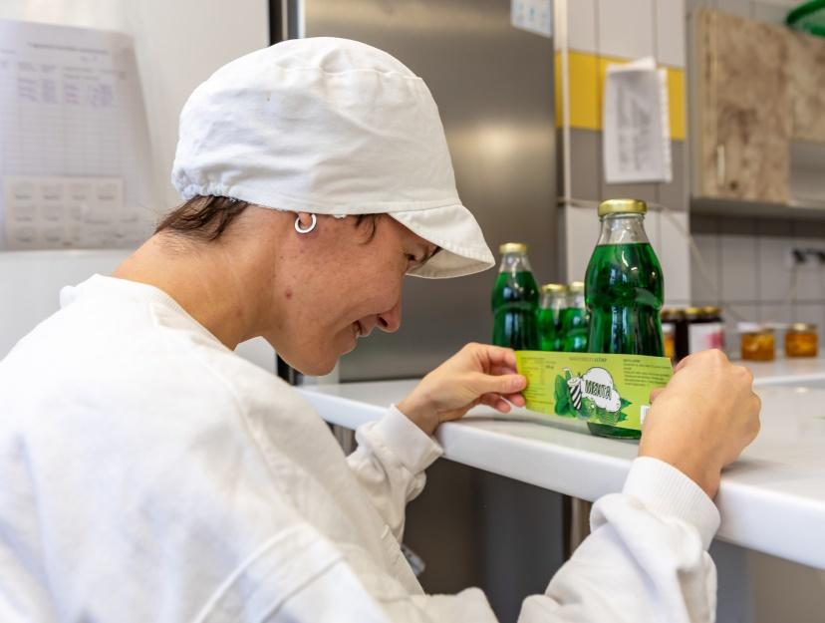
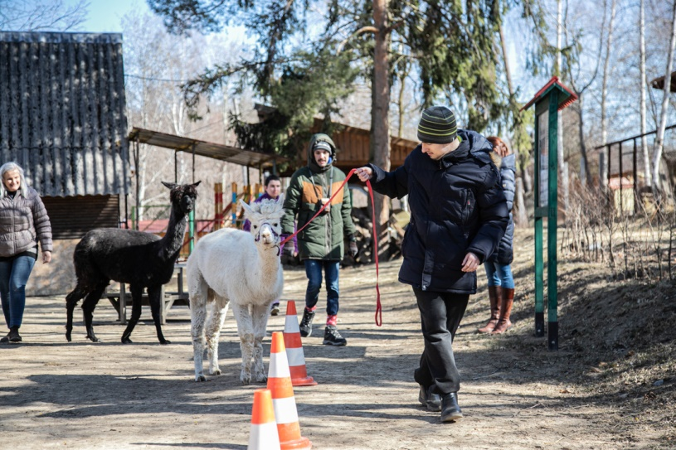

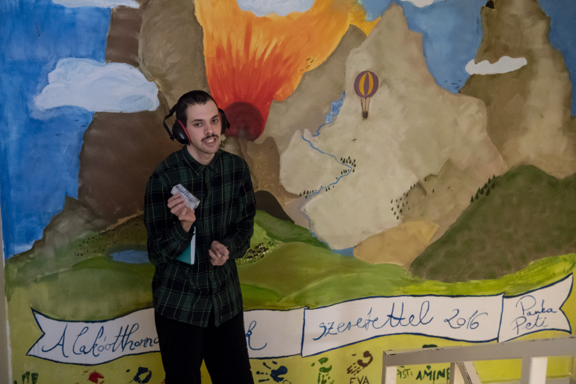
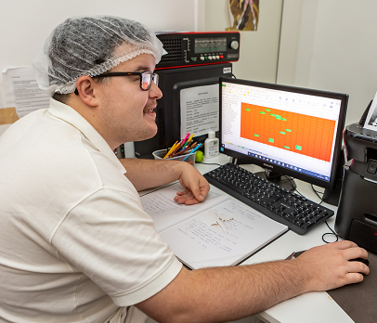
Autism in our everyday lives

Slide 9

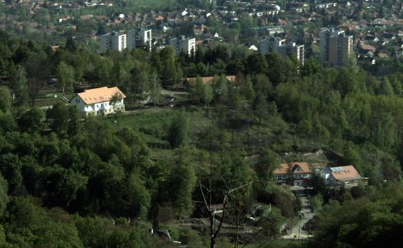

„Baráthegy” Manor – Village in the city

Slide 10
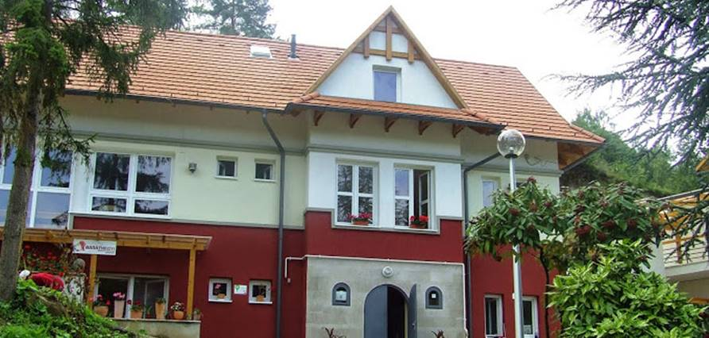
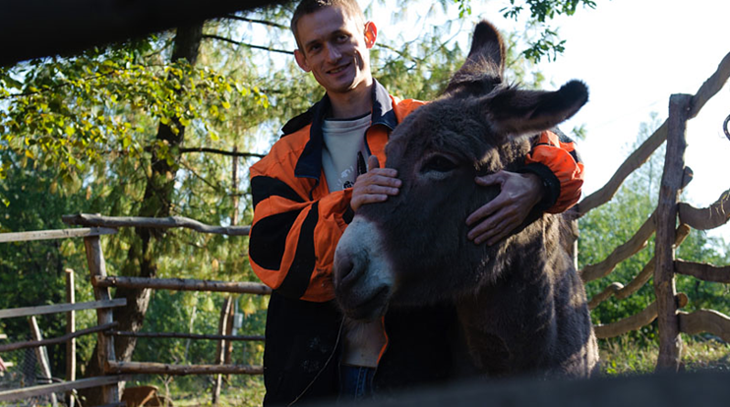
Socialtherapy
Employment

Slide 11
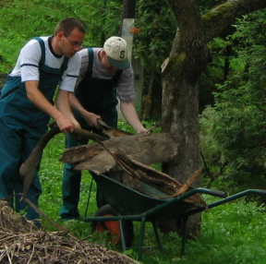
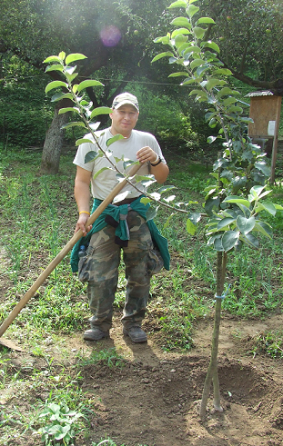
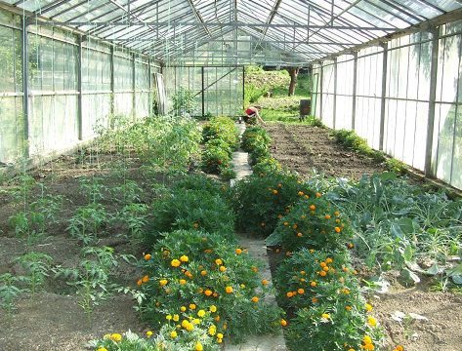
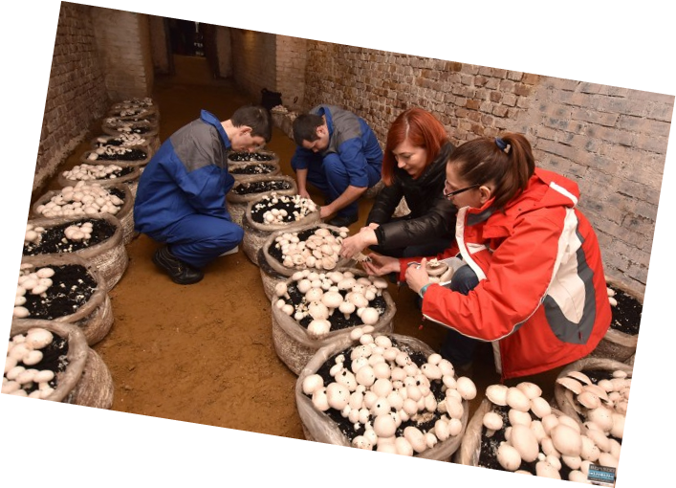
Gardening

Slide 12
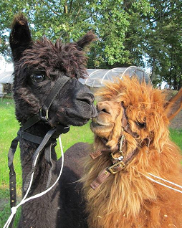
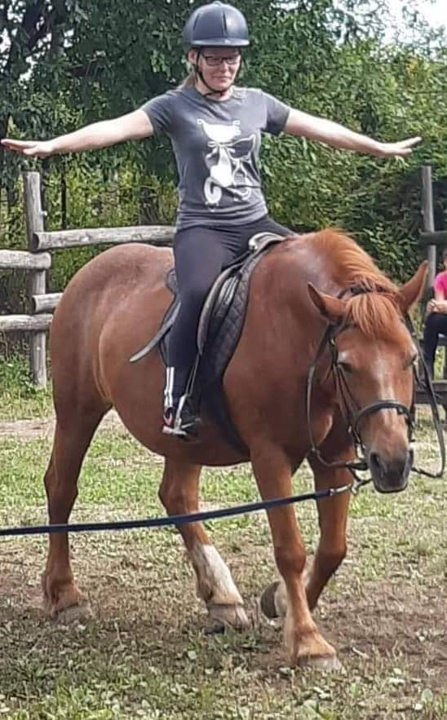
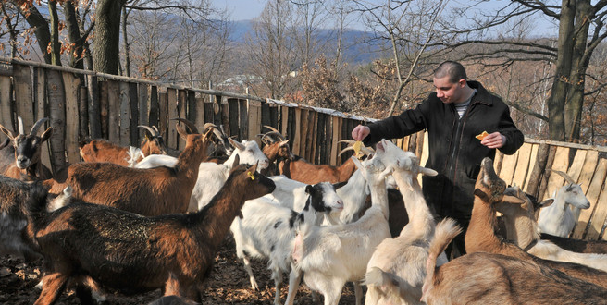
Animal husbandry

Slide 13
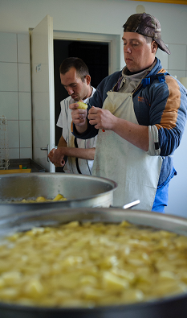
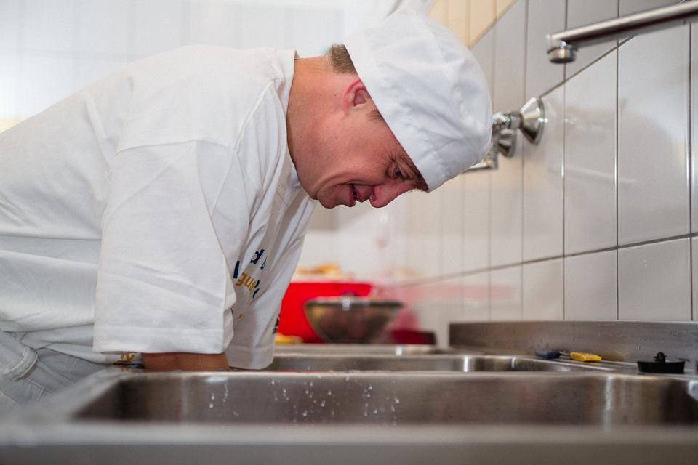
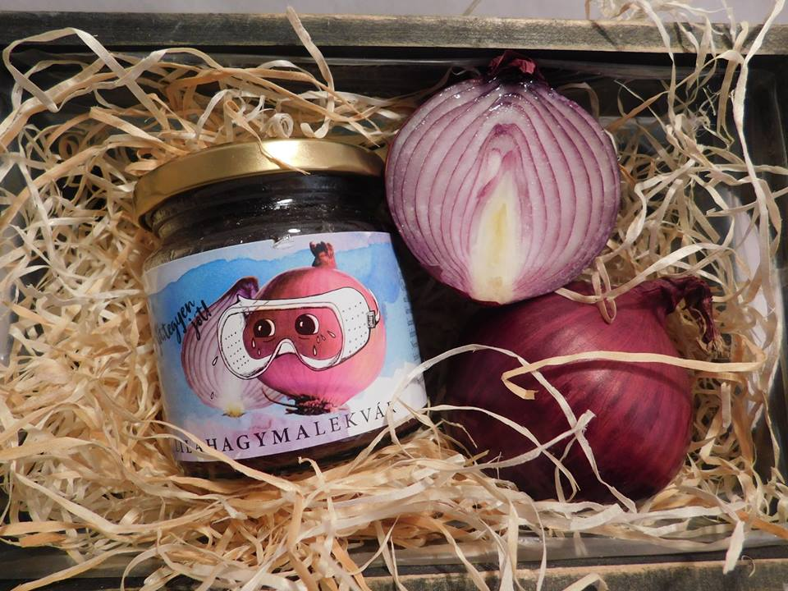
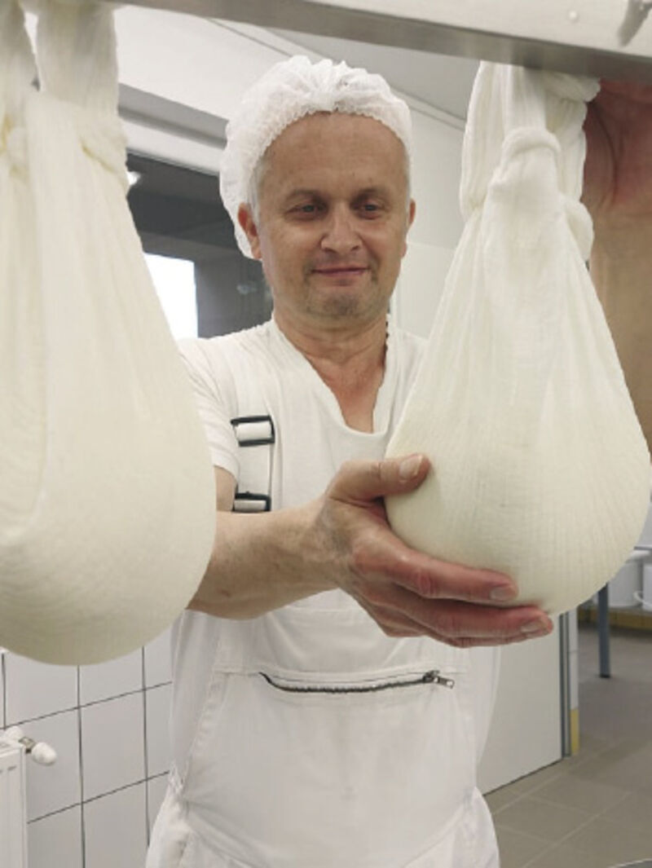
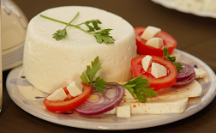
Food Production

Slide 14
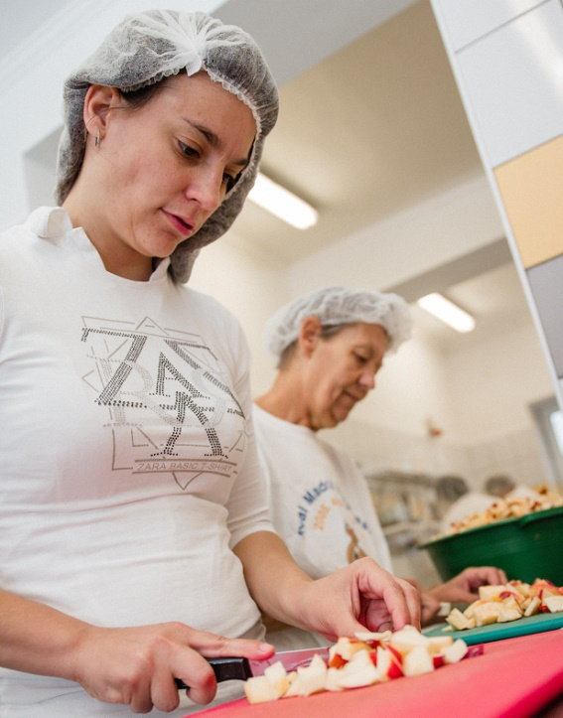
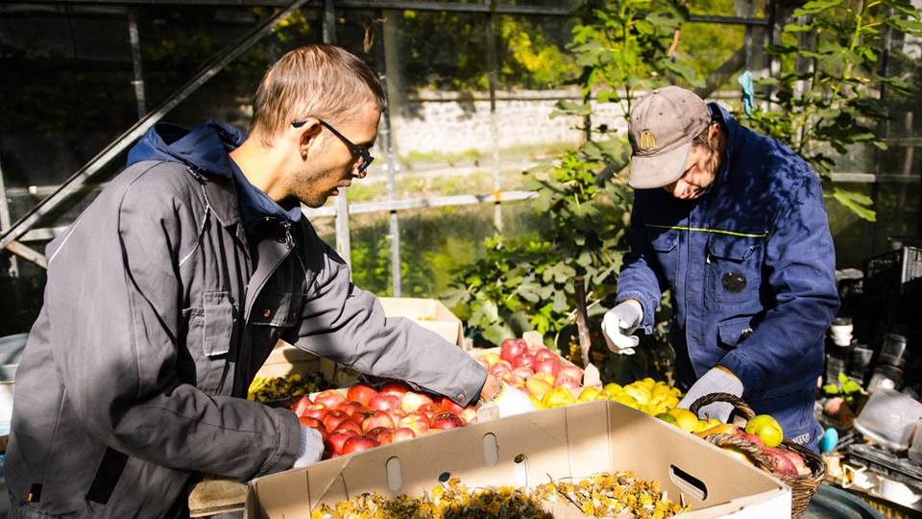
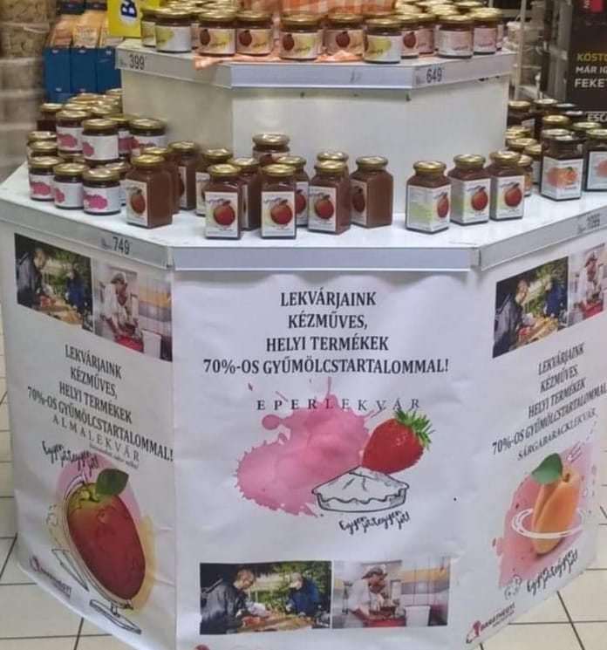
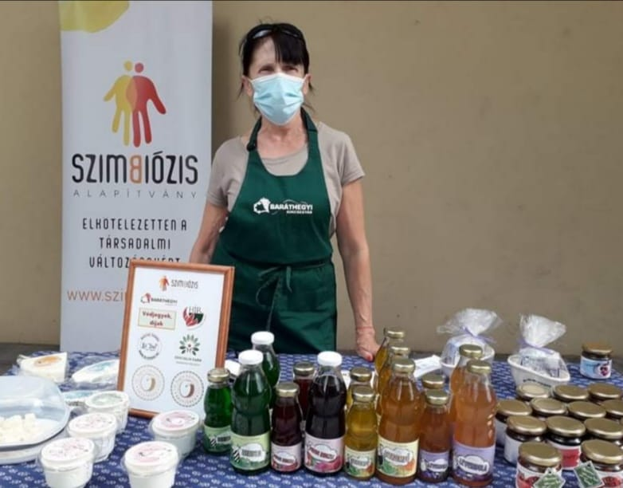
Local product: production -processing-sales

Slide 15
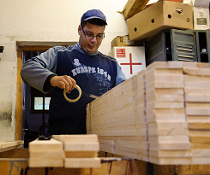
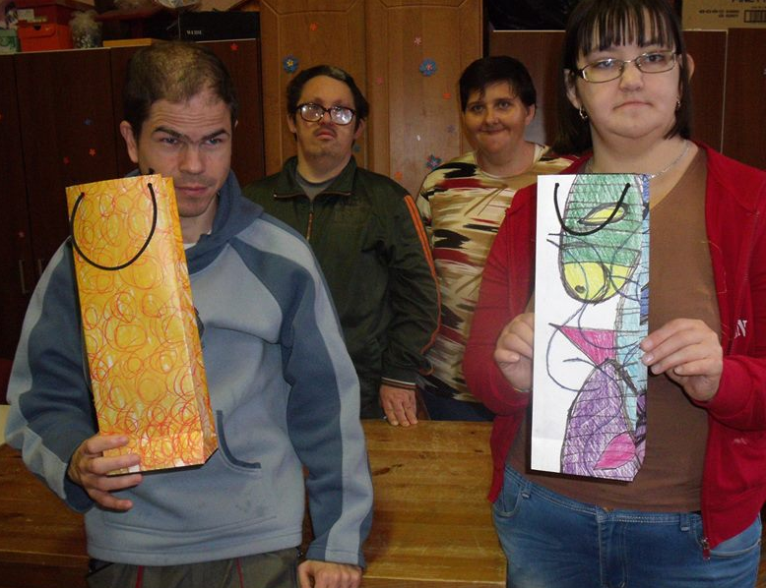
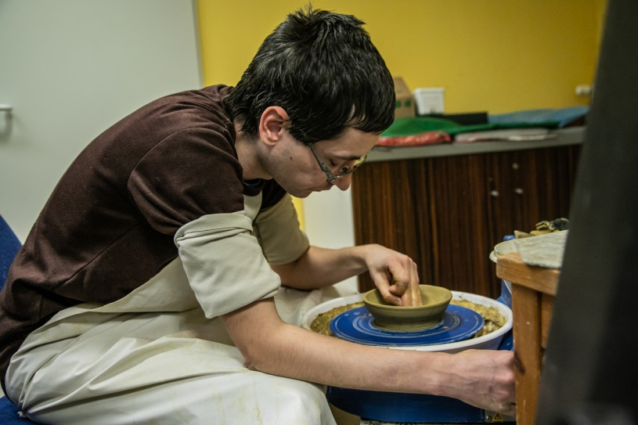
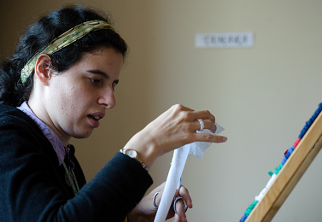
Craft workshops

Slide 16
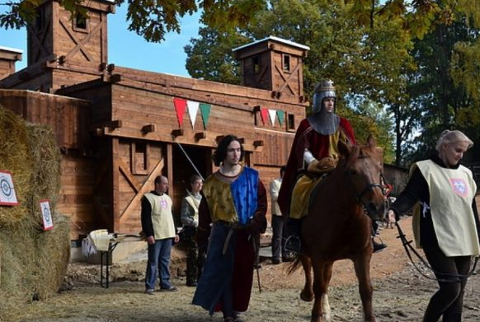
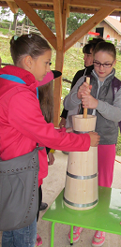
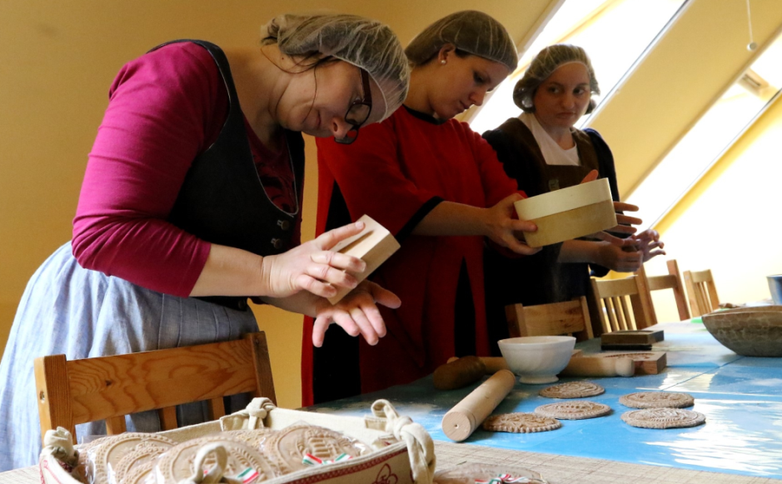
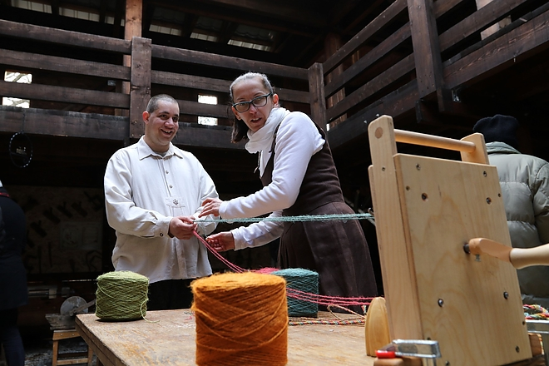
Tourism & traditions & experience

Slide 17
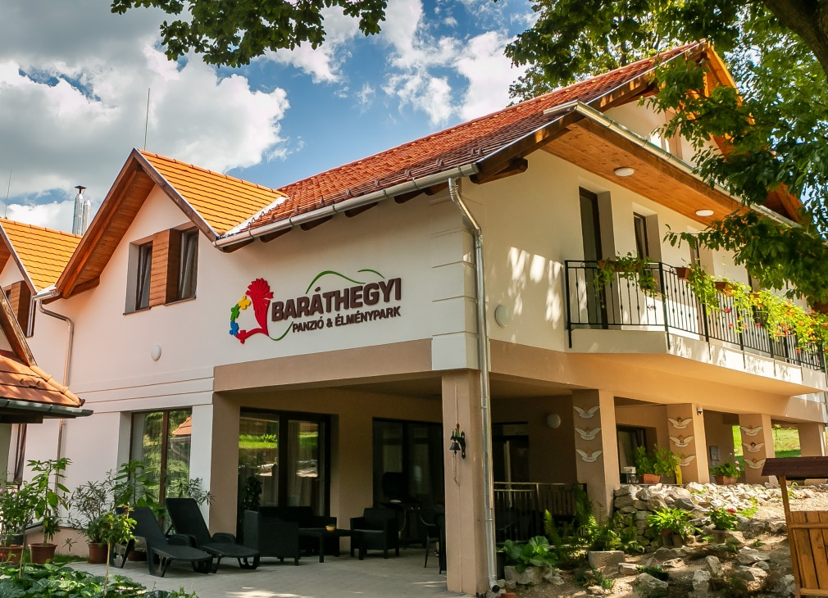

Eco- legend- adventure farm park & family spa queshouse
2021
one week in heaven

Slide 18
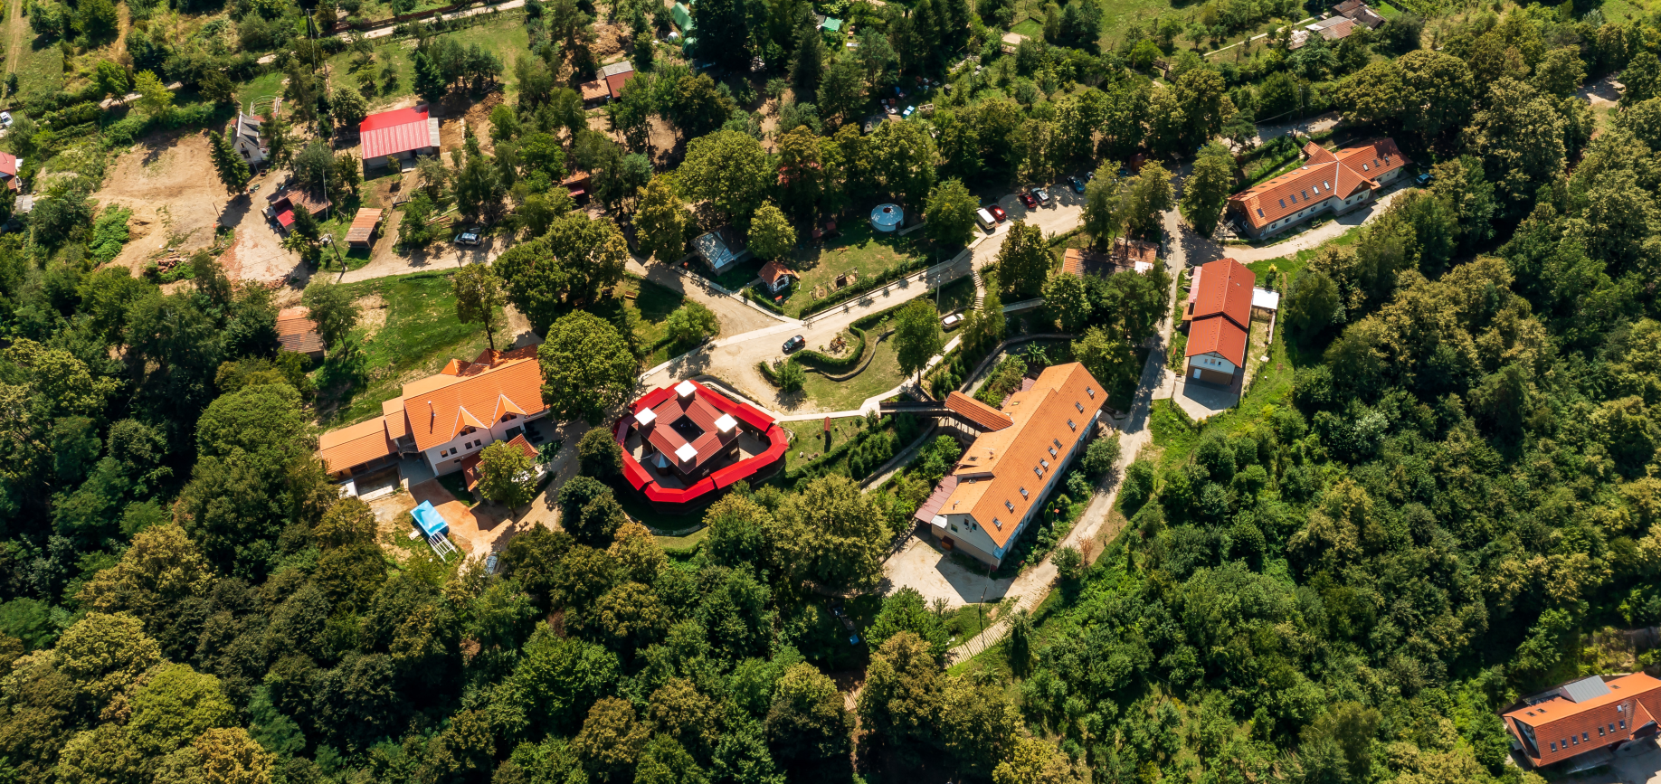
Transformation tourism

Slide 19
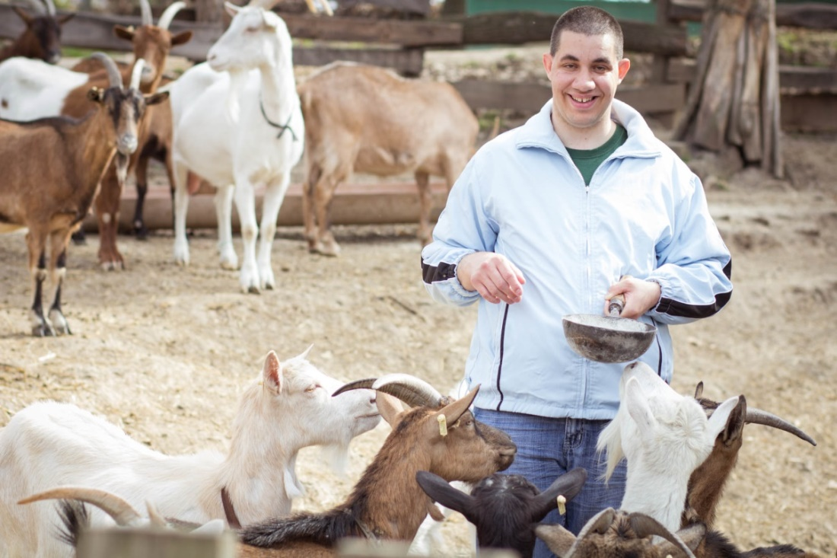
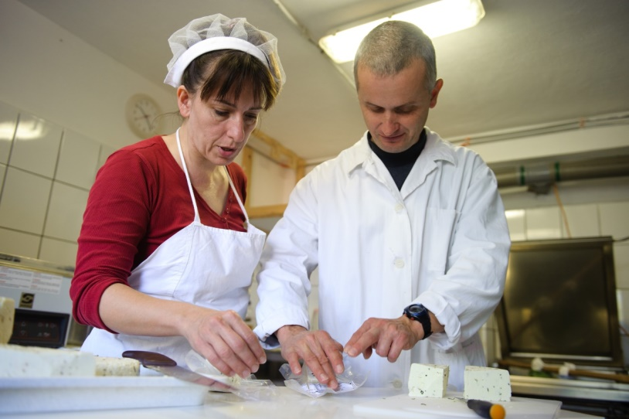
The story of Gyuszi, Zsuzsa, Imi

Slide 20






The story of Renáta

Slide 21




… FOLLOW UP

Slide 22



Story of Tamara és Dani

Slide 23


Zsuzsi Niki & Csaba

Slide 24




Everyone is different, but equally important to the community!

Slide 25

Be our guests!

Slide 26

We are always on the move!

Slide 27


THANK YOU FOR YOUR ATTENTION!
Contact
László Jakubinyi
e-mail: jakubinyi@szimbiozis.net
Szimbiózis Alapítvány
Baráthegyi Majorság
www.szimbiozis.net
www.barathegy.com

